Slide 1


Conception and implementation of E-Banking service
TUNISIAN REPUBLIC
MINISTRY OF HIGHER EDUCATION,
AND SCIENTIFIC RESEARCH
UNIVERSITY OF TUNIS AL MANAR
HIGHER INSTITUTE OF COMPUTER SCIENCE
Final year project
Presented by:
Tarek LAMMOUCHI
Eya TAIEB
Supervised by:
Mr. Imed BEN BOUKHATEM
Mrs. Fatma HERMES
Academic year 2016~2017
Notes:
Add higher university tunis el manar etc and end of studies internship

Slide 2
1
Plan
General representation
Requirements specification
Application design
Implementation
Conclusion & prespectives

Slide 3

General
2
Representation
Analysis of the current situation
Proposed solution
Chosen methodology

Slide 4


Analysis of the current situation
Proposed solution
3
E-banking service
Waste of time
Challenging environment
Growing needs

Slide 5
Scrum-XP lifecycle
Choice of methodology
4
Agile
Planning
Release 1
Release 2
Backlog product plan
Scrum
Sprint 1
XP
Sprints plan
Sprint 2
Releases plan
Notes:
Scrum XP mix

Slide 6

5
Requirements specification

Slide 7

Functional requirement
4
Authenticate
Manage profile
Consult banking accounts and their details
Client
Perform banking operations
Exploit geolocalization services

Slide 8
Non-Functional requirement
4
Performance
Maintainability
Security
Availability

Slide 9
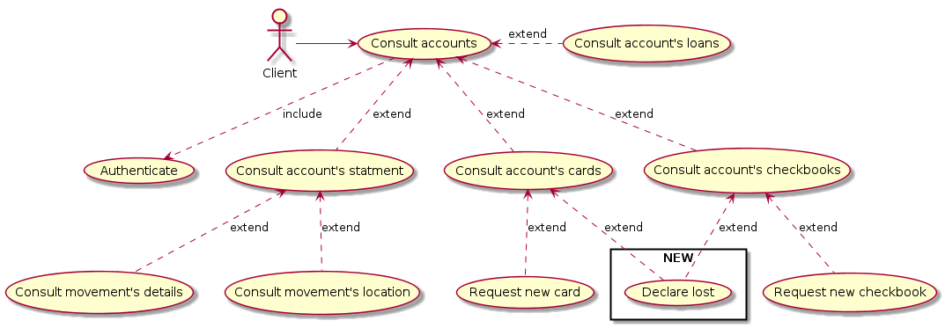
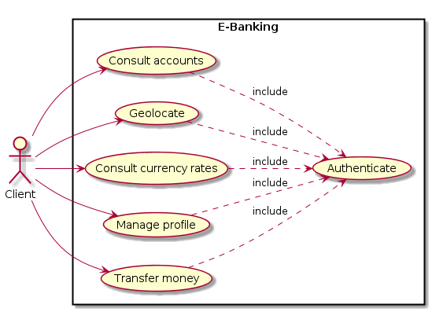
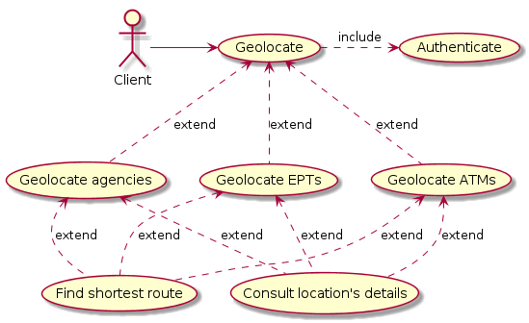
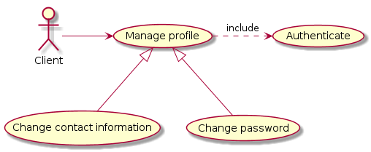
Use case diagram
4
Notes:
Sequence diagrams and class diagram

Slide 10

4
Application design

Slide 11




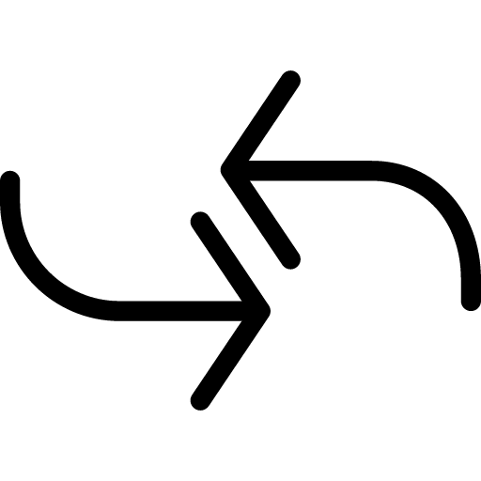

General architecture
6
STB e-banking service
Presentation layer
Business layer
Data layer
Models
Controllers
Dispatcher

Slide 12
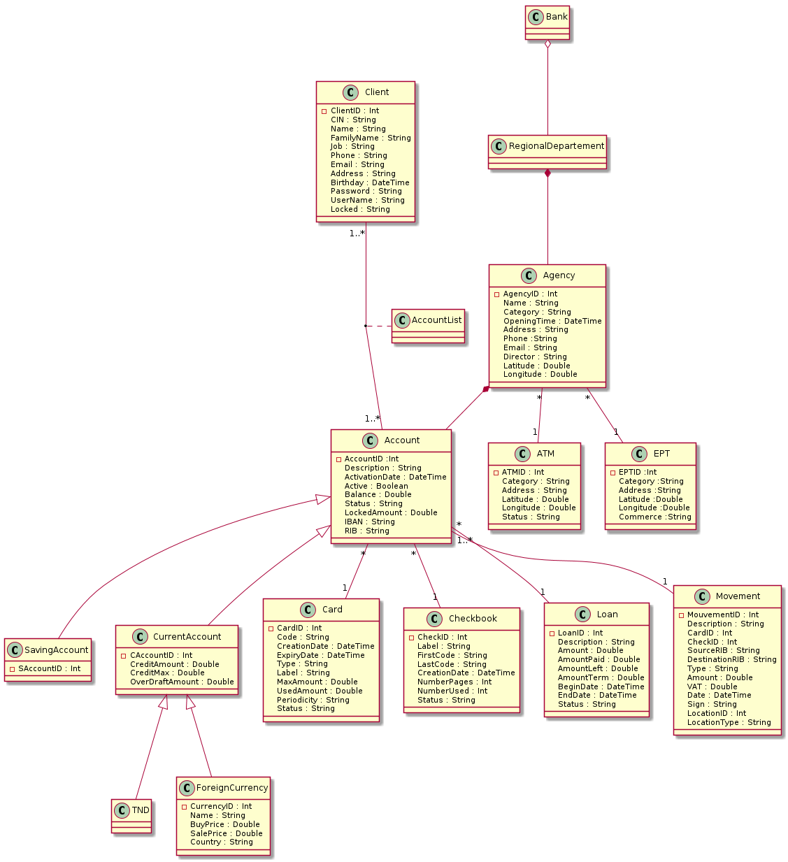
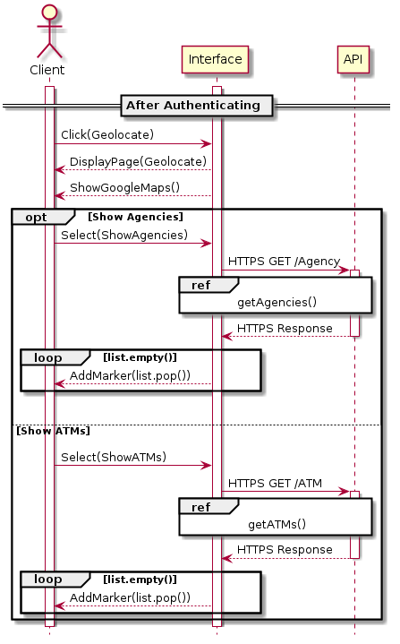
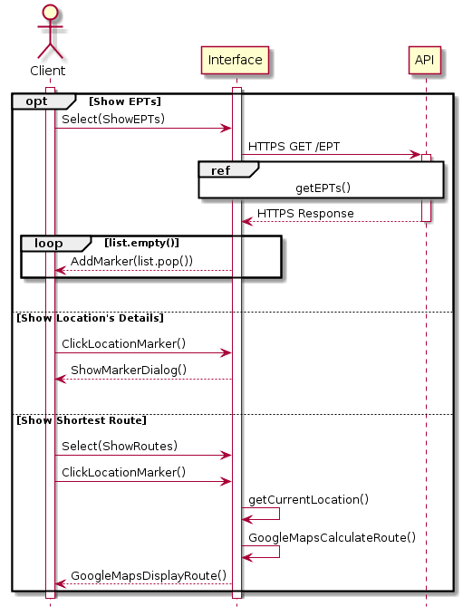
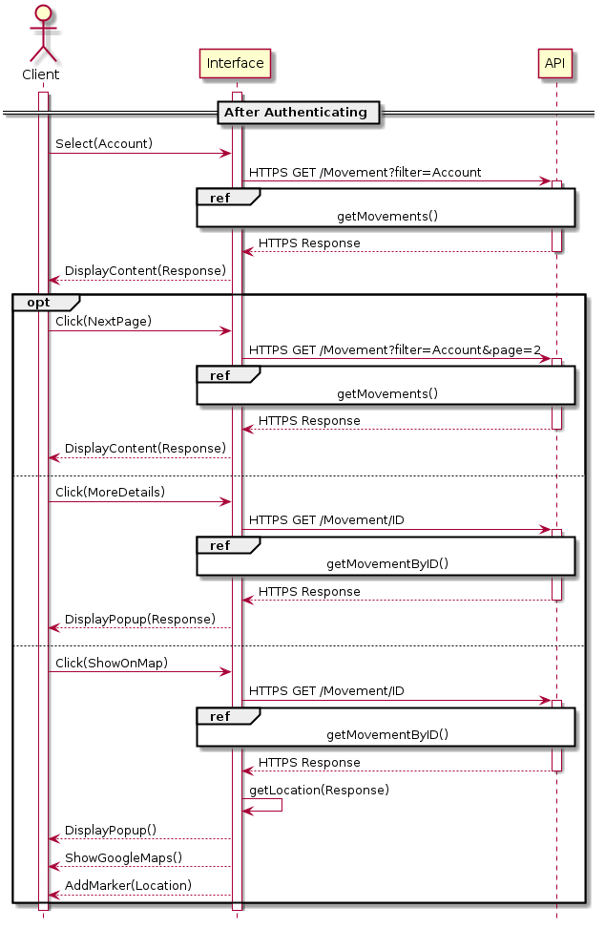
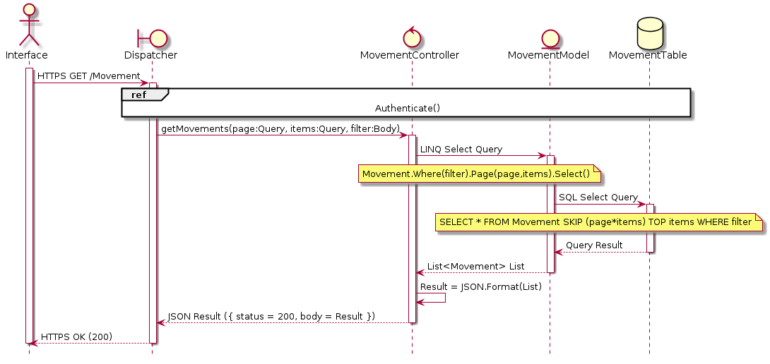
Consult account’s statement sequence
Geolocalization sequence
7
Class diagram

Slide 13

8
Implementation

Slide 14









Technologies
9

Slide 15
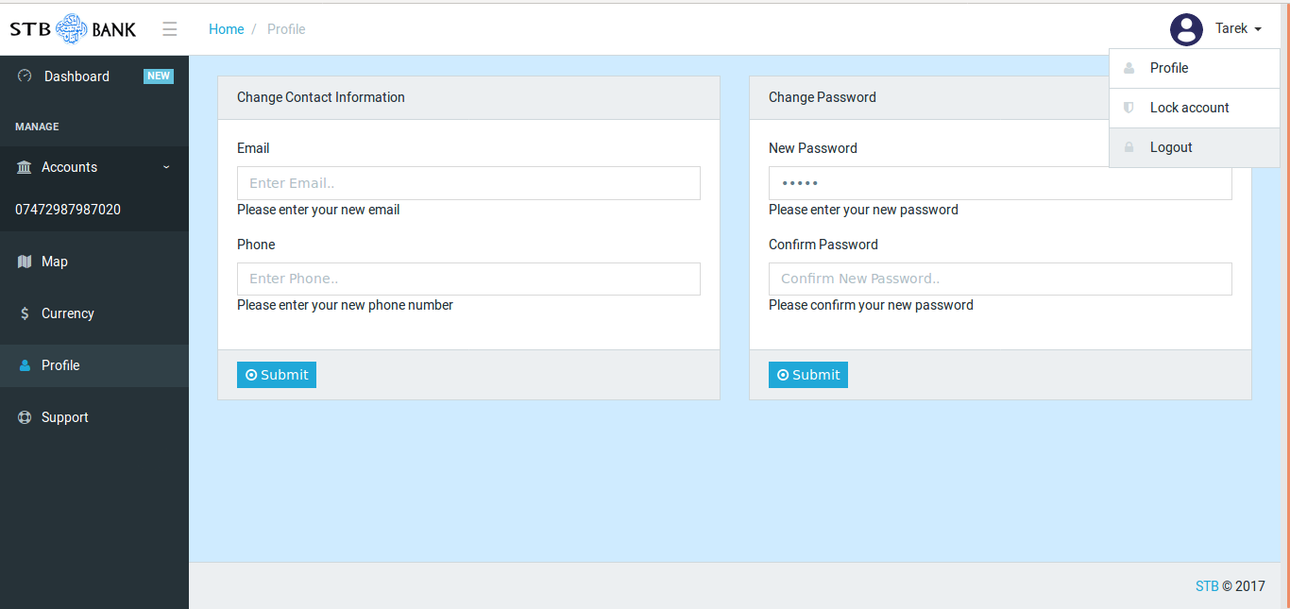
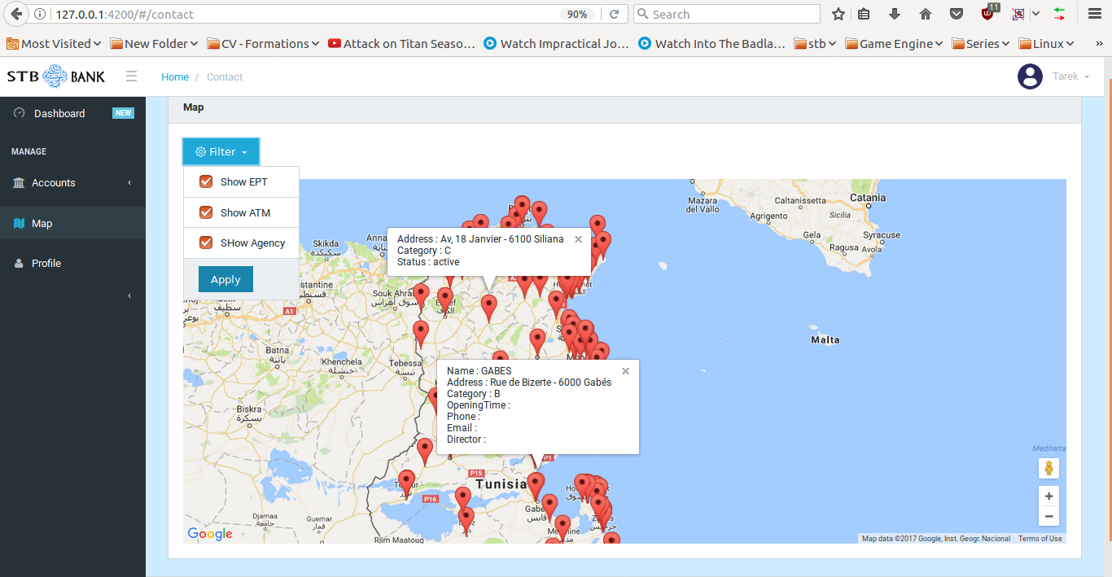
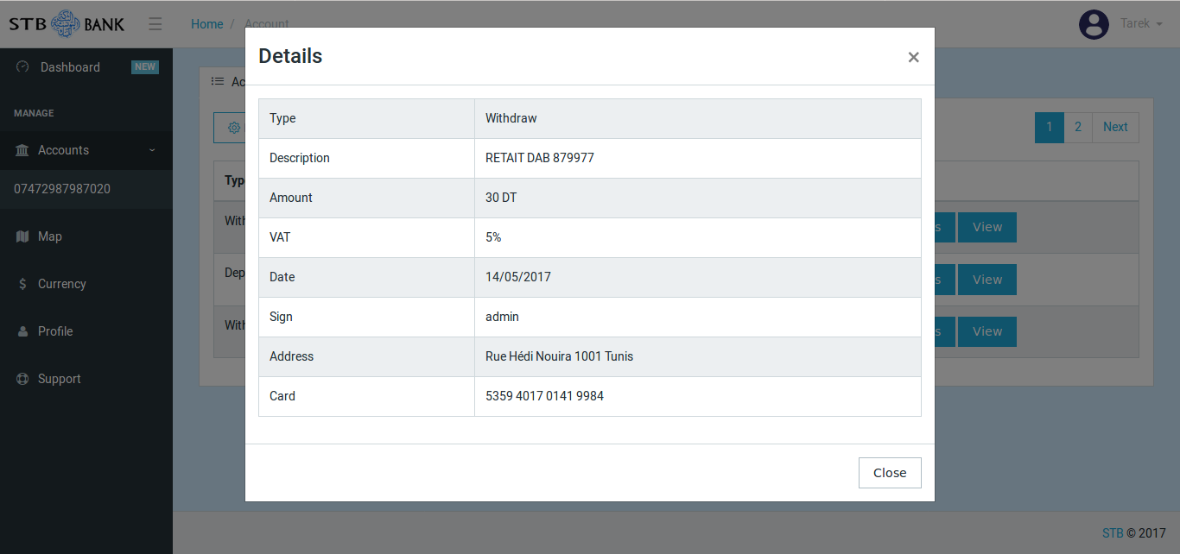
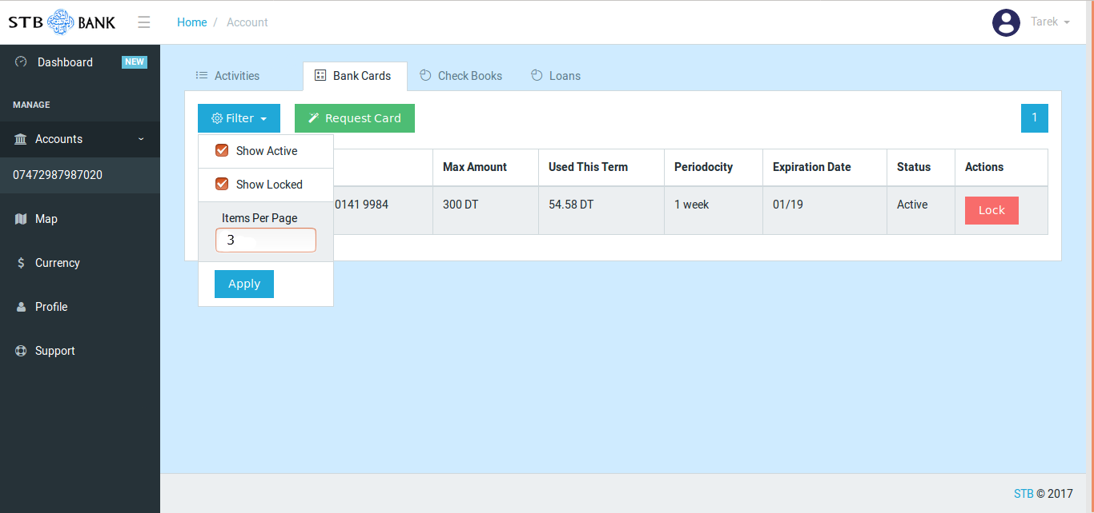
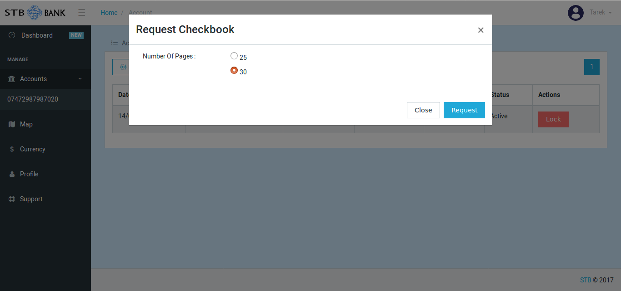
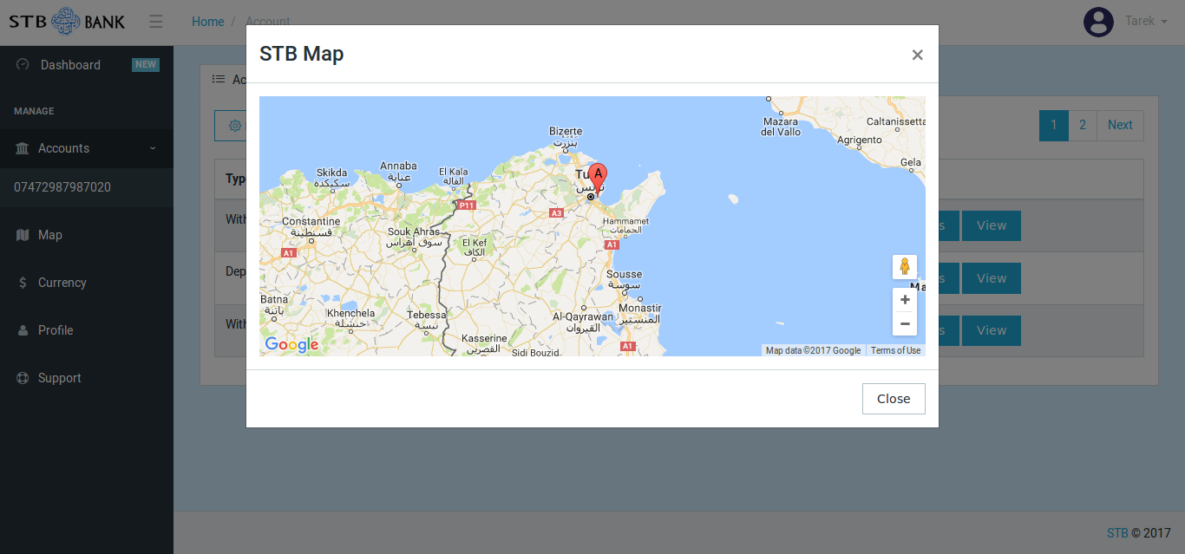
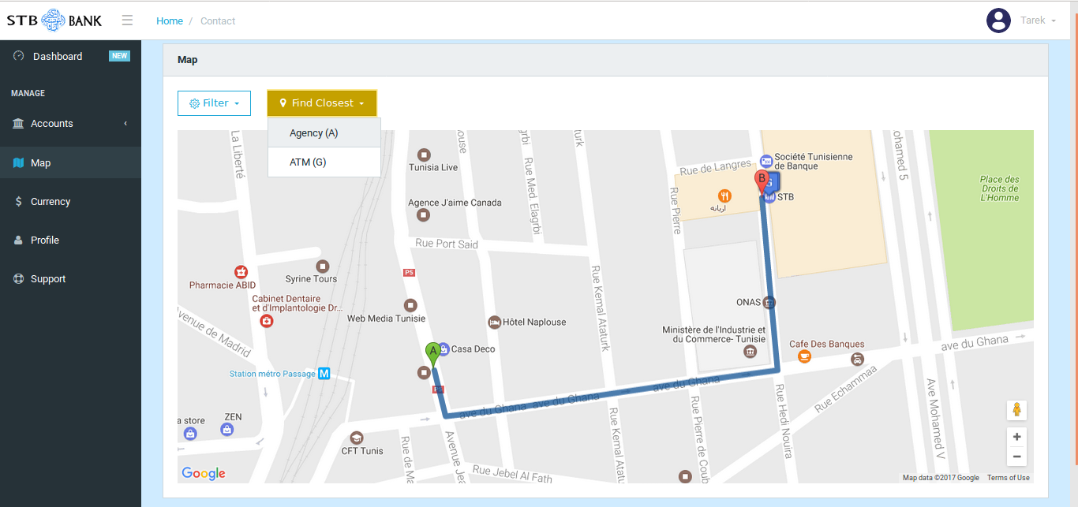
Manage account
Consult movement’s details
Consult cards status
Request a new checkbook
Consult shortest route to the closest agency
Consult currency rate
Consult movement’s location
10
Notes:
Wait for tarek

Slide 16
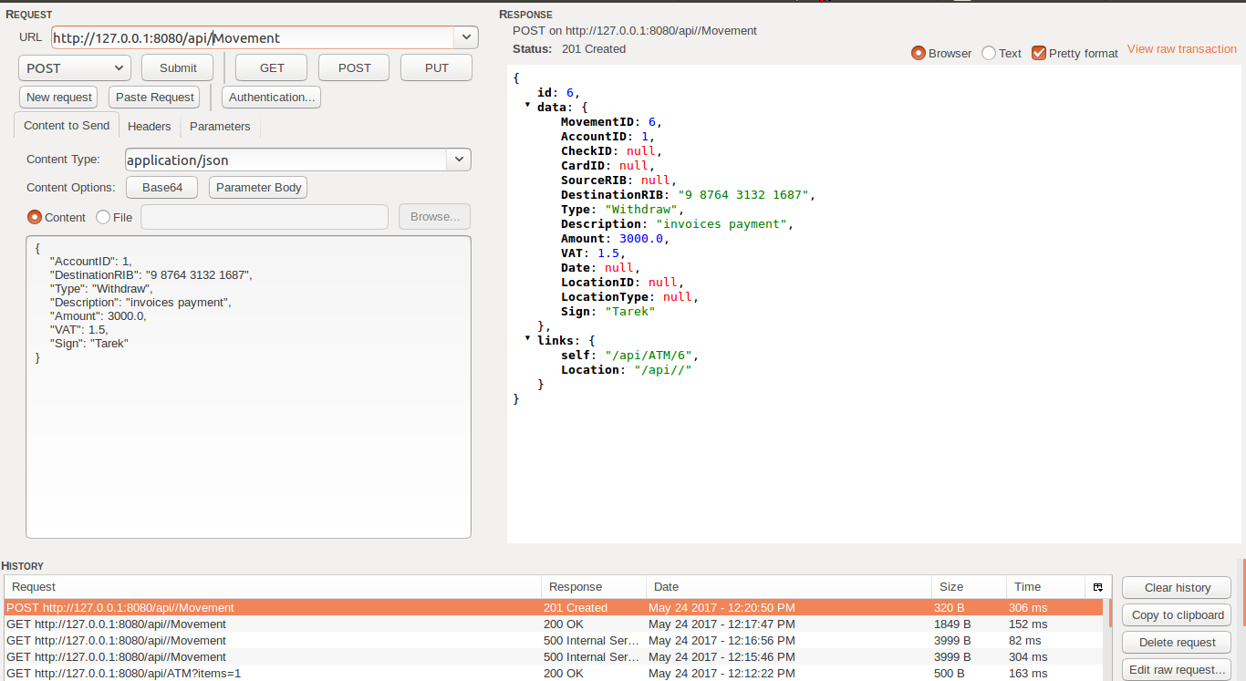
Testing
11
Place your screenshot here

Slide 17
12
Conclusion & perspectives

Slide 18












13
Perspectives
Notes:
To be discussed

Slide 19
Thank you for your attention!
15
Any questions?

